Slide 1
SharePoint Framework - Day 3
Jenkins NS
@jenkinsns

Slide 2

Agenda
Graph API
Microsoft Graph API Integration
Microsoft Graph API Tool kit
Isolated Webparts

Slide 3
Office 356 APIs
Service | Functionality | Base URL
Azure AD Graph | User, Groups Application, Devices | https://graph.windows.net
Exchange Online | Mail, Calendar, Contacts | https://outlook.office365.com/api
SharePoint Online | List, Libraries, Search, User Profiles | https://tenant.sharepoint.com/_api
OneDrive for Business | Files, Folders | https://tenant-my.sharepoint.com/_api
OneNote | Notebooks,Pages | https://onenote.com/api
Yammer | Conversations | https://yammer.com/api
Stream | Videos, Channels | https://tenant.sharepoint.com/portals

Slide 4
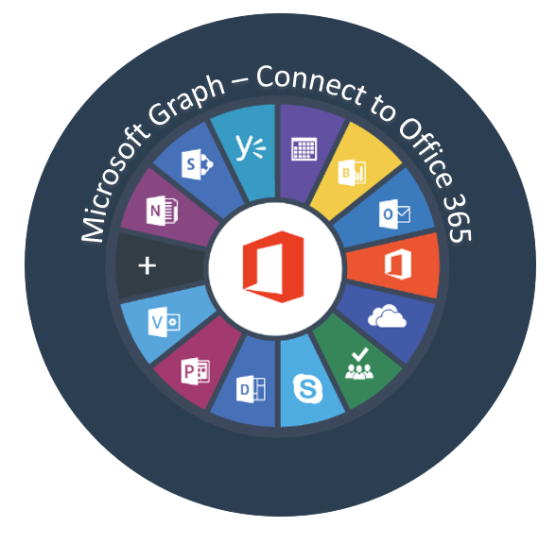
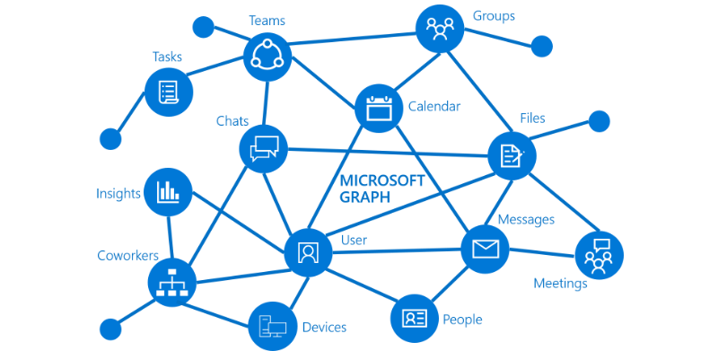
Overview of Microsoft Graph

Slide 5
What is Graph API?
Microsoft Graph exposes REST APIs and client libraries to access data on the following Microsoft 365 services:
Office 365 services: Delve, Excel, Microsoft Bookings, Microsoft Teams, OneDrive, OneNote, Outlook/Exchange, Planner, and SharePoint
Enterprise Mobility and Security services: Advanced Threat Analytics, Advanced Threat Protection, Azure Active Directory, Identity Manager, and Intune
Windows 10 services: activities, devices, notifications
Dynamics 365 Business Central

Slide 6
Microsoft Graph
Access user, group and organizational data
One endpoint One token
All users
Your App
https://graph.microsoft.com
Users
More…
#SPTechCon
Groups
SharePoint
Outlook
OneNote
Planner
Teams
Excel
Intune
Azure AD

Slide 7
Consume Microsoft Graph
You can now implement the below methods to consume the Microsoft Graph. You have two options:
Use the AadHttpClient client object
Use the MSGraphClient client object
SharePoint Framework v1.6.0 onwards supported consuming the MS Graph APIs and custom APIs.
Note:
SharePoint Framework v1.4.1 beta onwards MS Graph APIs supported.
You can consume the Microsoft Graph API with versions of SharePoint Framework earlier than v.1.4.1, either via the native graphHttpClient, or via a manual ADAL JS implicit OAuth flow.

Slide 8
AadHttpClient
AadHttpClient
The AadHttpClient client object is useful for consuming any REST API. You can use it to consume Microsoft Graph or any other third-party (or first-party) REST API and “AadHttpClient” is used to perform REST calls against an Azure AD Application, for example 3rd party WebAPI hosted in Azure.
For communicating with SharePoint, use the “SPHttpClient” class instead.
For communicating SharePoint with Microsoft Graph, use the MSGraphClient class.
this.props.context.aadHttpClientFactory
.getClient('https://graph.microsoft.com’)
.then((client: AadHttpClient) => {
// Search for the users with givenName, surname, or displayName equal to the searchFor value
return client .get( `https://graph.microsoft.com/v1.0/users?$select=displayName,mail,userPrincipalName&$filter=(givenName%20eq%20'${escape(this.state.searchFor)}')%20or%20(surname%20eq%20'${escape(this.state.searchFor)}')%20or%20(displayName%20eq%20'${escape(this.state.searchFor)}')`, AadHttpClient.configurations.v1
);
})
.then(response => {
return response.json();
})

Slide 9
MSGraphClient object
MSGraphClient
“MSGraphClient” is used to perform REST calls against Microsoft Graph. The Microsoft Graph JavaScript client library is a lightweight wrapper around the Microsoft Graph API. This class allows developers to start making REST calls to MSGraph without needing to initialize the MSGraph client library.
The MSGraphClient client object can consume the Microsoft Graph only. Internally it uses the AadHttpClient client object and supports the fluent syntax of the Microsoft Graph SDK.
Supported from SPFx v1.4.1 (Initial beta release of MSGraphClient class)
MSGraphClient is a new HTTP client introduced in SharePoint Framework v1.6.0
this.props.context.msGraphClientFactory
.getClient()
.then((client: MSGraphClient): void => {
// From https://github.com/microsoftgraph/msgraph-sdk-javascript sample
client
.api("users")
.version("v1.0")
.select("displayName,mail,userPrincipalName")
.filter(`(givenName eq '${escape(this.state.searchFor)}') or (surname eq '${escape(this.state.searchFor)}') or (displayName eq '${escape(this.state.searchFor)}')`)
.get((err, res) => {
if (err) { console.error(err); return; }

Slide 10
API Permissions
To consume Microsoft Graph or any other third-party REST API, you need to explicitly declare the permission requirements from an OAuth perspective in the manifest of your solution.
In the SharePoint Framework v.1.4.1 or later, you can do that by configuring the webApiPermissionRequests property in the package-solution.json under the config folder of the solution.
Microsoft Graph permission names follow a simple pattern: resource.operation.constraint..Read grants permission to read the profile of the signed-in user.
User.ReadWrite grants permission to read and modify the profile of the signed-in user and
Mail.Send grants permission to send mail on behalf of the signed-in user.
"webApiPermissionRequests": [
{
"resource": "Microsoft Graph",
"scope": "User.ReadBasic.All"
}
]
https://docs.microsoft.com/en-us/graph/api/resources/team?view=graph-rest-1.0
Notes:
https://docs.microsoft.com/en-us/graph/api/resources/team?view=graph-rest-1.0
https://developer.microsoft.com/en-us/graph/graph-explorer#
https://docs.microsoft.com/en-us/graph/permissions-reference

Slide 11
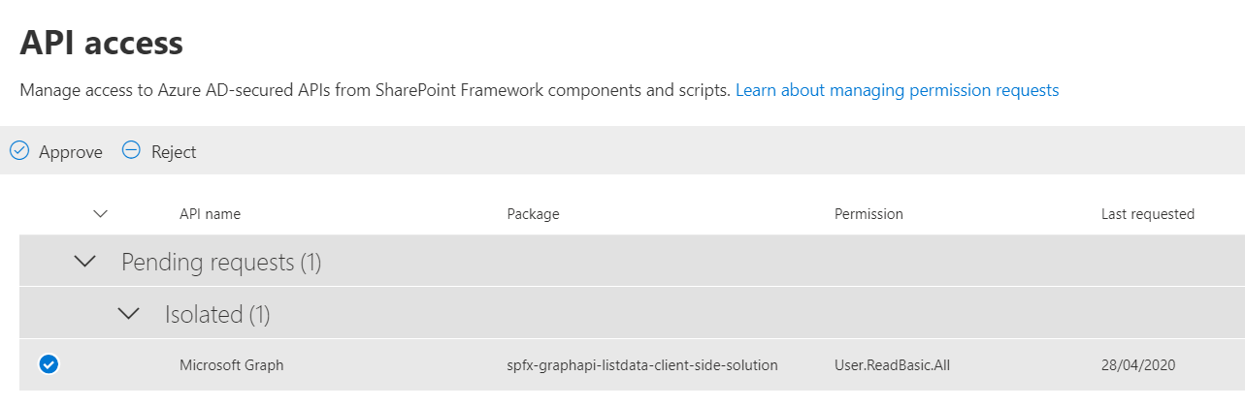
API access

Slide 12
Isolated Webparts

Slide 13
Why Isolated web parts?
To allow your SharePoint Framework solutions to securely access APIs secured with Azure AD, you can use the API management to specify which APIs can be accessed by scripts in your tenant and with which permissions.
Using the SharePoint Framework, you can easily retrieve an access token for the specific API.
While it significantly simplifies communicating with APIs secured with Azure AD, it allows all scripts, not just specific SharePoint Framework solutions, to obtain an access token for any of the approved APIs. If one of the scripts you use in your tenant was exploited, then it could access any of the approved APIs on behalf of the current user.
SharePoint Framework v1.8.0 onwards has addressed this situation by introducing isolated web parts
Isolated web parts introduce a new way to isolate access to APIs secured with Azure AD and ensure that only specific SharePoint Framework web parts are allowed to obtain an access token for the particular API.
If your web part requires permission to access any backend API or Graph, it is strongly recommended to have the web part isolated.
We should protect the access token which is used behind the scenes and make sure that no other script on the page will piggy-back the permissions we are using. Isolated web part is one step towards handling security concerns.

Slide 14
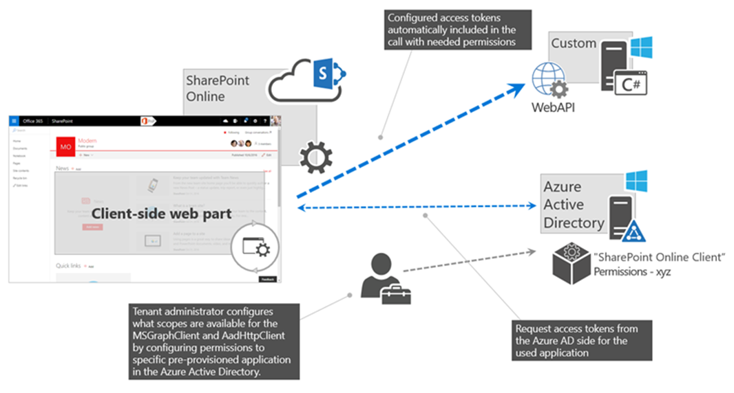
Isolated web parts

Slide 15
Isolated web parts benefits
Web parts from an isolated SPFx package run on a unique domain, hosted within an iFrame - the permissions granted apply only to code hosted on that domain.
Regular SPFx web parts run on your *.sharepoint.com domain, the granted permissions do not apply there.
And since any other SPFx isolated web parts run on a different unique domain, they don't apply there either.
Essentially, the shared application principal for SPFx is not used – instead, an AAD app registration dedicated to this SPFx solution is created and used for authentication.
Note this scope isn’t the individual web part, but the containing solution package.
This is fine however - if you have an untrusted source contributing code to the very same solution/codebase, then you probably have bigger security and governance challenges to deal with quite frankly.
In the ‘config/package-solution.json’ file, set the isDomainIsolated property to true.
"isDomainIsolated": true

Slide 16
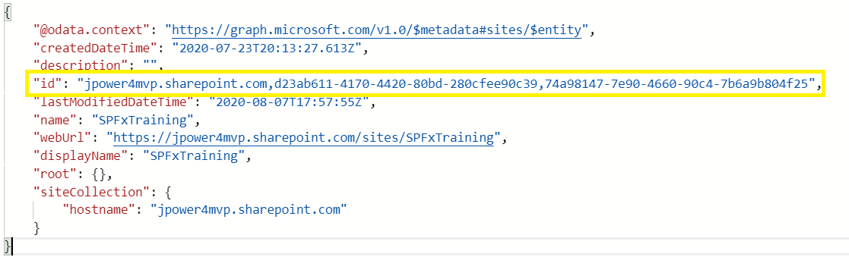
Different Ways to Get SharePoint Site Collection using Microsoft Graph API
We can access the site collection using three different ways in Microsoft Graph API:
By using the root - Get Top level SharePoint site collection by using ‘root’ - sites('root’)
Ex: sites('root')/lists('SPFxContacts')/items?expand=fields
By using the Site server relative URL - sites/jpower4mvp.sharepoint.com:/sites/SPFxTraining
Ex: sites/jpower4mvp.sharepoint.com:/sites/SPFxTraining:/lists/SPFxContacts/items?expand=fields
By using the Site ID
Ex: sites('jpower4mvp.sharepoint.com,d23ab611-4170-4420-80bd-280cfee90c39,74a98147-7e90-4660-90c4-7b6a9b804f25')/lists('SPFxContacts')/items?expand=fields
Get SiteID
To get site id using relative URL in Microsoft Graph Explorer
https://graph.microsoft.com/v1.0/sites/jpower4mvp.sharepoint.com:/sites/SPFxTraining

Slide 17
Demo
Retrieve SharePoint List Items Using Microsoft Graph API for SPFx

Slide 18
Agenda
SharePoint Framework Extensions
SharePoint Framework Extensions Overview
Types of Extensions
Creating an application customizer
Creating a field customizer
Creating a command set
SPFx Library
Creating a Library

Slide 19
Introduction
SPFx Extension overview

Slide 20

SPFx Extension
SharePoint Framework v1.3.0 - Sep 25 2017
Extend user experience within modern pages & libraries
Customize notification areas, toolbars, and list data views

Slide 21
SharePoint Framework Extensions Overview
You can use SharePoint Framework (SPFx) Extensions to extend the SharePoint user experience. With SPFx Extensions, you can customize more facets of the SharePoint experience, including notification areas, toolbars, and list data views. SPFx Extensions are available in all Microsoft 365 subscriptions for production usage.
SPFx Extensions enable you to extend the SharePoint user experience within modern pages and document libraries, while using the familiar SPFx tools and libraries for client-side development. Specifically, the SPFx includes three extension types:
Application Customizers
Field Customizers:
Command Sets:

Slide 22
SPFx has three extension types
Application Customizers
Allows HTML placeholders with custom rendering.
It is helpful in embedding js code snippets.
Deployment scope varies from Site collection to Site to list level.
Field Customizers
It is helpful in modifying data views in a list.
It can be used along with site column or a list column to override its presentation in the list.
Command Sets
It helps to extend the SharePoint Command surfaces to add actions, which can work with client-side codes.
Toolbars and context menus can be created using this.
Helps to add action buttons to the list.

Slide 23
Application Customizer
Demo

Slide 24
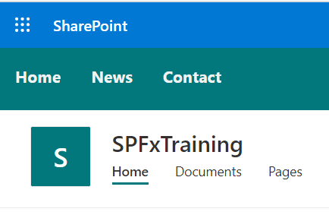
SPFx Application Customizer
Allows HTML placeholders with custom rendering.
It is helpful in embedding js code snippets.
It is helpful in embedding css code snippets.
Deployment scope varies from Site collection to Site to list level.

Slide 25
Field Customizer
Demo

Slide 26
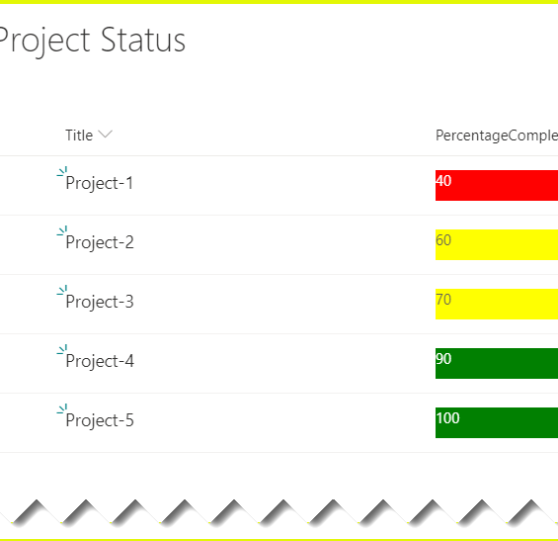
SPFx Field Customizer
By using SPFx field customizers we can modify the list views.
onInit(): The onInit() method get called after this.context and this.properties are assigned, but before the page DOM is ready.
onRenderCell(): onRenderCell() event triggered when each cell is rendered.
onDisposeCell(): onDisposeCell() is used to free up resources that were allocated while rendering.

Slide 27
Listview Command Set Customizer
Demo

Slide 28
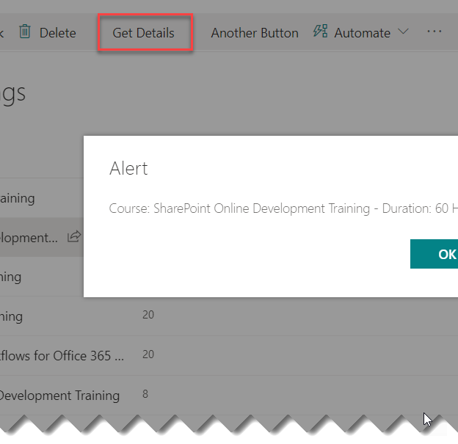
Listview Customizer Command Set
By using command sets, we can add new actions with client-side code to implement the behaviors.
onRenderCell():
onRenderCell() event triggered when each cell is rendered. Here we can use the event.domElement HTML element to extend our functionality.

Slide 29
Demo
Create an Application customizer extension
Create a Field customizer extension
Create a command set extension
Create a Library component for SPFx webpart

Slide 30
Agenda
Microsoft Teams tabs using SharePoint Framework
Create a Microsoft Teams tab project
Packaging and deploying your web part to SharePoint
Making the web part available in Microsoft Teams

Slide 31
Introduction
SPFx + MS Teams

Slide 32
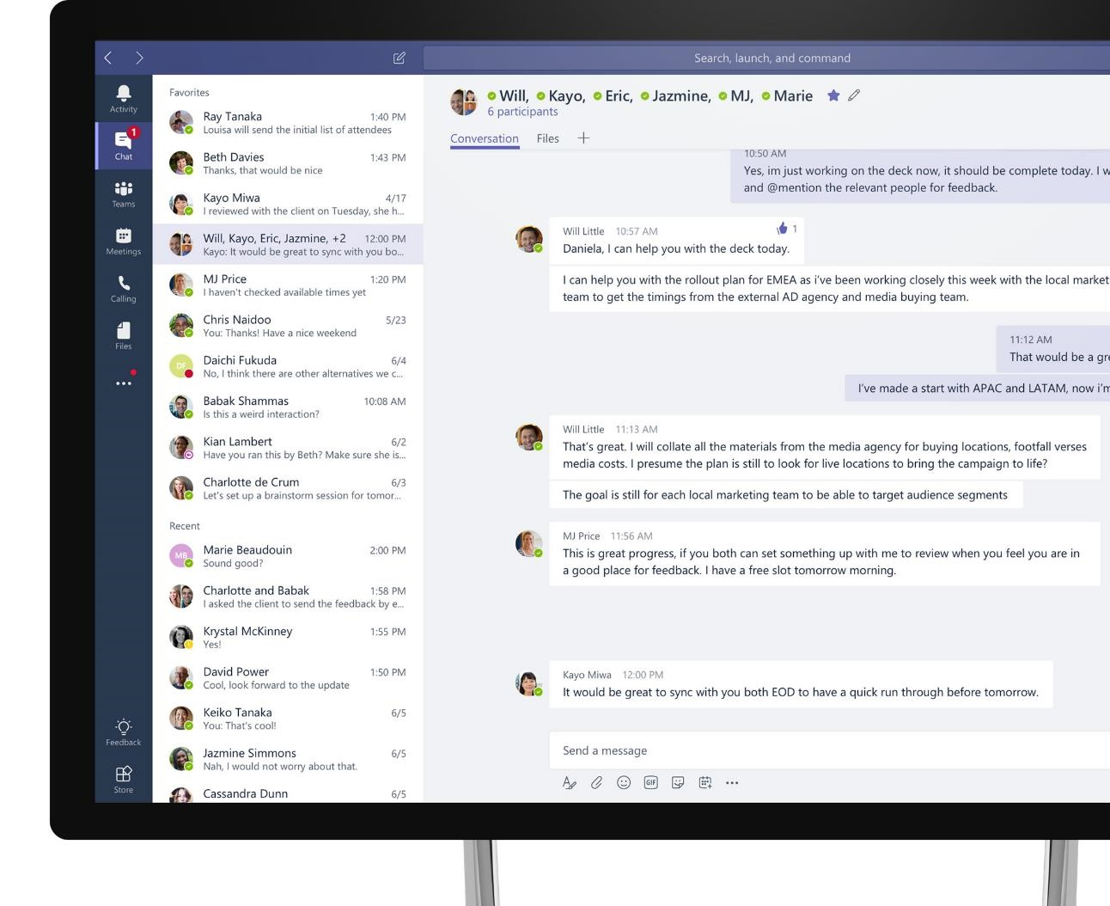
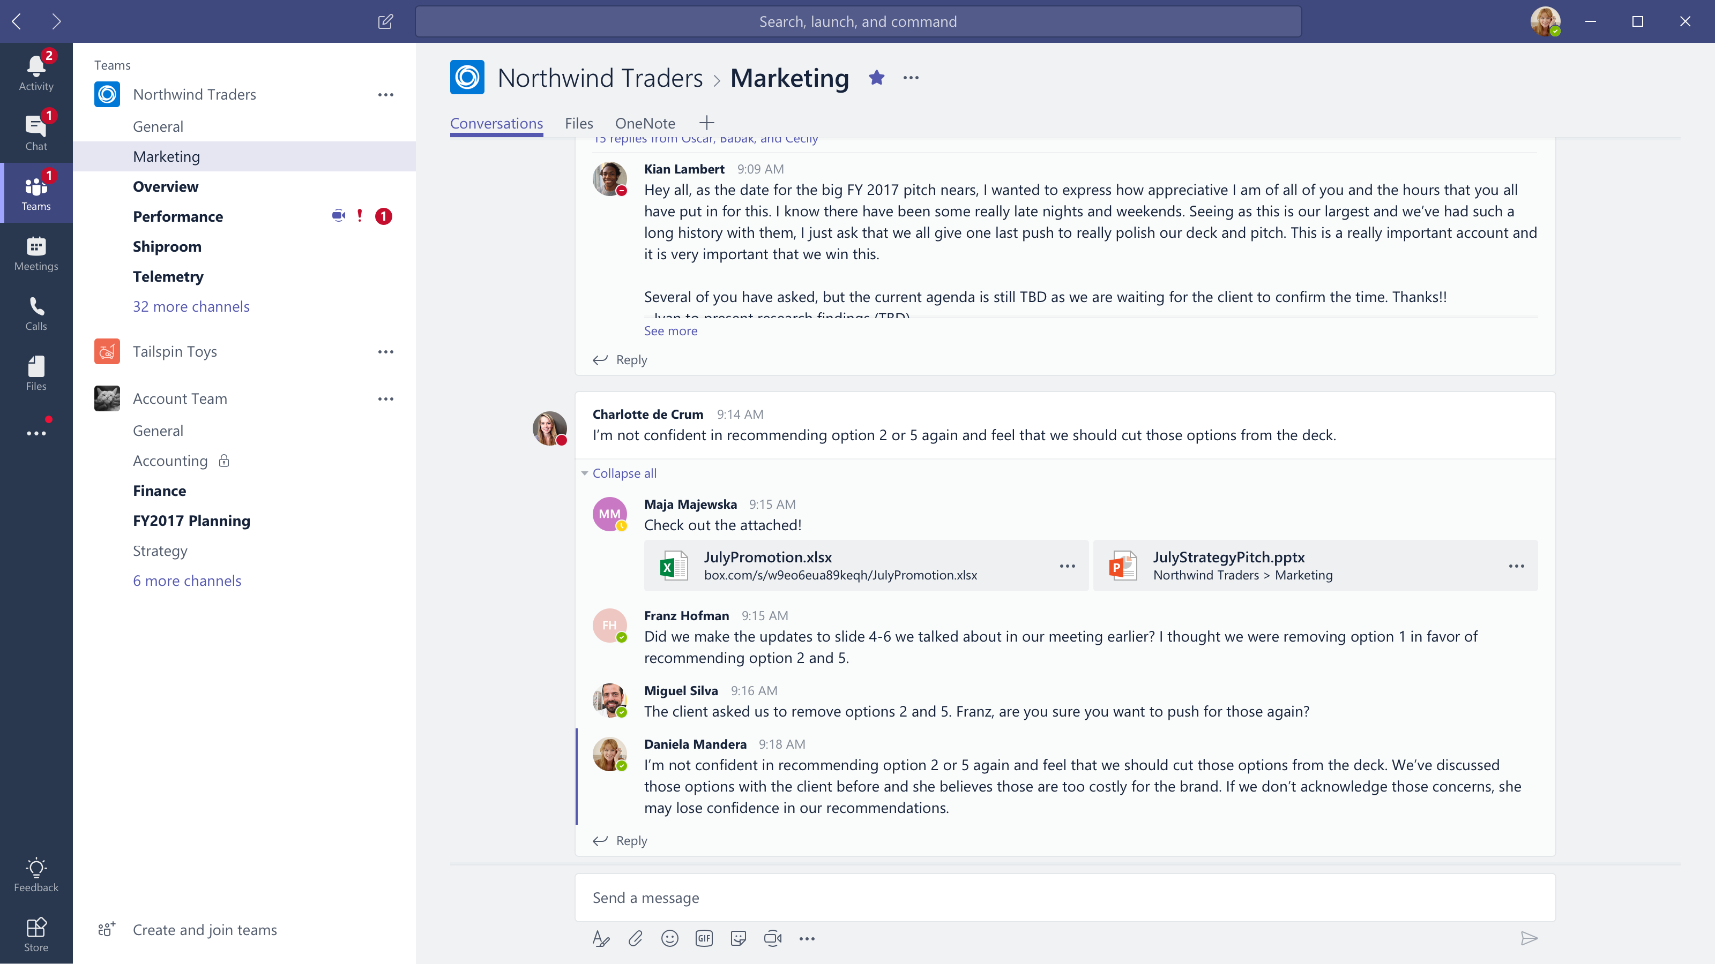


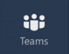
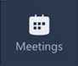
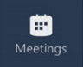




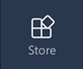
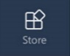
Microsoft Teams
The hub for teamwork in Office 365
Communicate
through chat, meetings & calls
Collaborate
with deeply integrated Office 365 apps
Customize & extend
with 3rd party apps, processes, and devices
Work with confidence
enterprise level security, compliance, and manageability
Notes:
[This is an animated slide. Please show it in presentation mode]
[MAIN POINT TO LAND]
Microsoft Teams is a hub for teamwork, a chat-based workspace that enables teams to be more productive by giving them a single and secure location that brings together everything a team needs: chats, meetings, calls, files, and tools. Microsoft Teams is one place for all the needs your teams have.
Microsoft Teams delivers on four core promises to create a digital workspace for high performing teams.
[COMMUNICATE]
First, Microsoft Teams solves for the communication needs of a diverse workforce.
Since preview, Microsoft Teams has evolved to include a complete meetings experience, as well as chat, voice and video -
You can use Teams for informal 1:1 or group chats – directly on your phone if you’re on the go. Or you can have an open conversation in a channel. This enables people to share information in a transparent way to accelerate decision making. And it's super easy to move from a chat into a face to face meeting, helping you to bridge geographical barriers.
[COLLABORATE]
When it comes to collaboration, the deep Office integration enables today’s multigenerational workforce to use the Office apps they are familiar with and love - Word, Excel, PowerPoint, OneNote, SharePoint, Planner, even Power BI - right within the context of Teams. Teams is unique in how we enable collaboration.
Today, when you want somebody’s feedback, you send them the file via email, they store it locally with comments, you store it again…… it's a vicious cycle that results in v2, v3, v4 versions – and you have to jump between email and other apps to get the work done. Teams brings all the Office 365 services together – so that you can easily share and co-author files without the need for email attachments.
[CUSTOMIZE]
Many of you use other services than Office 365 as well which results in you having to jump between and spend time in disparate experiences. We built Teams to not only be the hub for Office 365 services, but for all the services and tools teams use on a day to day basis. So, you can customize Teams with tabs, connector and bots to include the apps and services you need - <mention relevant 3rd party apps like GitHub and Trello that can be included in Teams>– we have integrations with over 150 partners. For our developer community, we have also created an extensible platform, to enable building apps and to integrate with business processes.
[WORK WITH CONFIDENCE]
Microsoft Teams comes with the enterprise grade security, compliance and manageability that you expect from Office 365 which customers tell us is a huge value add for them.

Slide 33


Current State of SharePoint and Teams
SharePoint Extensibility
Build modern SP solutions
Full-trust JavaScript based framework running in the main app
Use modern auth to integrate with Graph
SP add-ins
Provider-hosted based via iframes
Low-trust, end user acquisition model
Distribute via Office Store
Teams Platform
Build apps to custom tailor your teams
Modern embedding via tabs
Enhance integrations via bots, messaging extensions, Adaptive cards, and Graph
Add communication services, e.g. programmable voice and video

Slide 34
Our Expectations
Information the team cares about should be available regardless of the tool / workload
Make it possible to bridge team collaboration and external communication
End user
Enable users to collaborate around the same content in SharePoint and Teams
Centralized Admin experience and tools, including LOB app distribution
Common developer framework for building solutions targeting both SharePoint and Teams experiences
Reduce the number of places and ways to manage and deploy solutions to end users
IT admin
Reach multiple workloads with a single solution
Reduce number of developer concepts and experiences
Developer

Slide 35



Single platform for hosted experiences
O365-hosted apps
(“SPFx solutions”)
Provider-hosted apps
Rich canvases
Common platform and runtime
Microsoft Graph
Build your solution to run across Teams, SharePoint, and (eventually) all of Office

Slide 36
Surfacing SPFx in Teams
Deploy your existing SharePoint web part into Teams as a tab
This features available from 1.7 plus beta version.
yo @microsoft/sharepoint

Slide 37
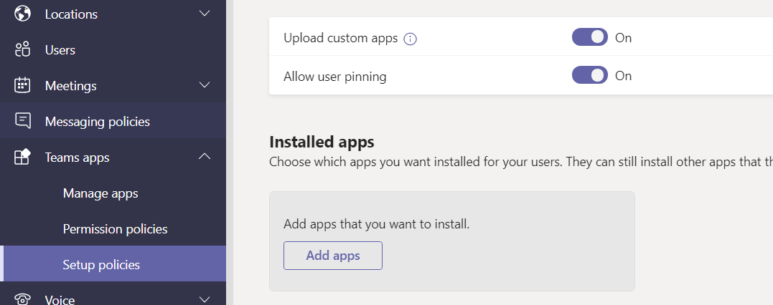
Instructions for enabling side loading
As part of the Developer of SharePoint Framework Teams Tabs, you will need to explicitly deploy the Microsoft Teams app to a Team in Microsoft Team. Your tenant will also need to support Side loading of custom apps for the Microsoft Teams, so that you can deploy the app to a specific Team and use it
Go to https://admin.teams.microsoft.com/
Teams apps
Setup policy
Add or edit exiting global (org-wide default)

Slide 38
Bring SPFx Solutions into Teams Tab

Slide 39
SPFx Targeting Teams Tabs
SPFX as the standard way for Enterprise Devs and SIs to Develop “O365-hosted” solutions across SharePoint and Teams
Developers will be able to “target” the environments in the manifest.json
Single point of governance in the App Catalog
Standard “features” of SPFx
Toolchain
Authentication
SP, Graph and WebAPI Access
CDN hosting
Config experience
Solution hosting
Component is able to get the right application context

Slide 40

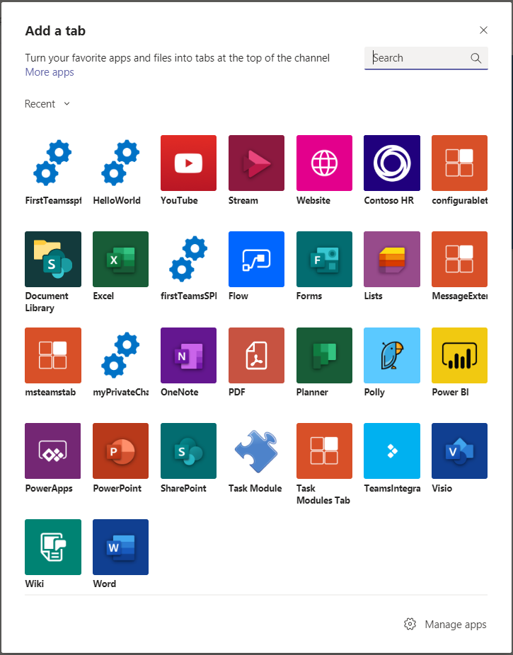
Bring SPFx Solutions into Teams Tab
SPFx Teams solutions are deployed to Office 365 tenants using tenant app catalog
Microsoft Teams
SharePoint Online
1
Teams manifest file is created and deployed in Teams LoB Catalog
2
zip
Tenant App catalog
User selects the SPFx application like any other tab in MS Teams “Add a tab” experience
js
SPFx solution
3
Configuration panel is displayed and, once saved, information are stored in the SPO site connected to the group
4
Configuration List

Slide 41
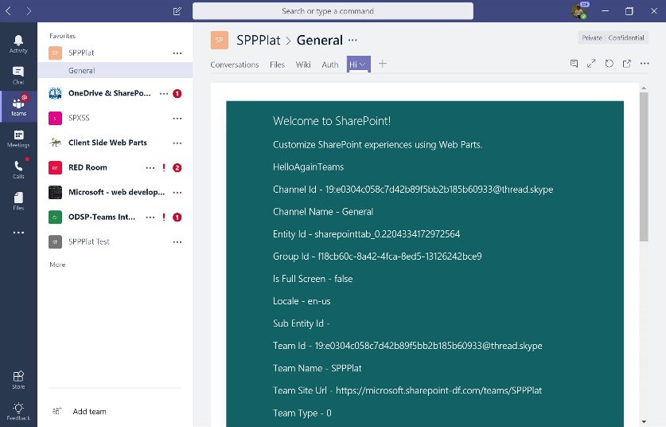
Bring SPFx Solutions into Teams Tab
SPFx component renders in a dedicated _layout page which is iframed in Teams
Microsoft Teams
SharePoint Online
5
Teams and SharePoint site context are available to developer
6
SPFx Application
Code is loaded from SharePoint asset library where it was deployed at time of package upload
Webpart.aspx
7
Alternatively, code can also run in different CDN location
js
7
js
Asset Library
js
js

Slide 42
Authentication
Silent authentication between Teams rich client and SPO
Teams provides the token client side to SharePoint
It convert it to cookie server side
The _layout system page that hosts the SPFx solution renders: no additional auth required
Full access to SharePoint REST APIs
When / if the component requires to access Graph / Web APIs:
We get the auth token from the client: no permissions there, we use it as bootstrap token
SPFx client libraries understand that the call is coming from a Teams rich client environment*
Bootstrap token is sent to AAD using the “on behalf of” flow to obtain an access token for the requested resource in exchange for the bootstrap token
AAD returns the access token to SPO. The component can now execute the Web API call.

Slide 43
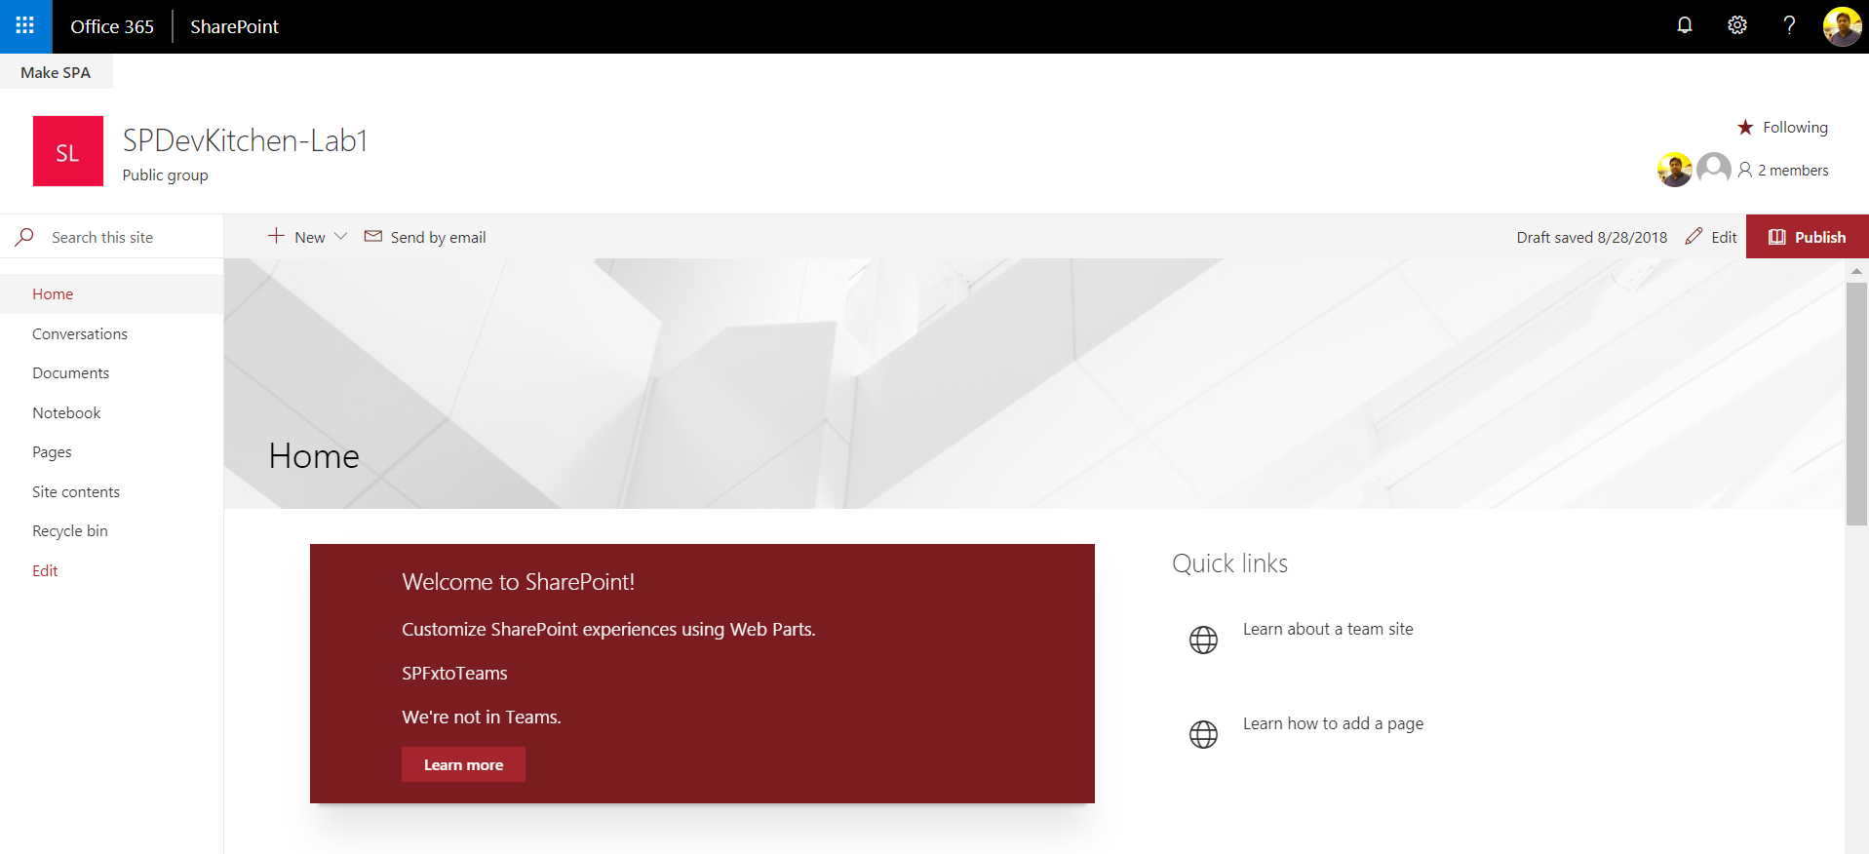

Slide 44
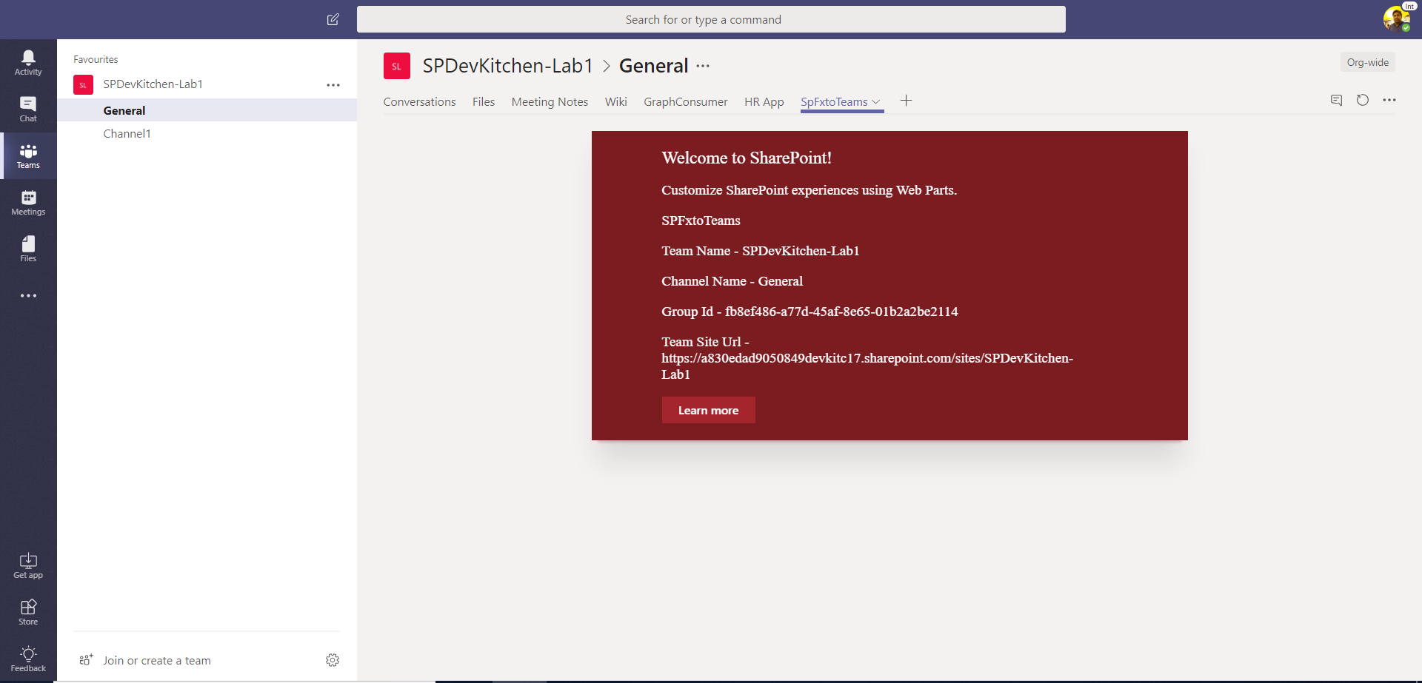

Slide 45
Demo

Slide 46
Demo
SPFx + MS Teams Webpart

Slide 47
References
Overview of the SharePoint Framework
https://docs.microsoft.com/sharepoint/dev/spfx/sharepoint-framework-overview
Overview of SharePoint Framework Extensions
https://docs.microsoft.com/sharepoint/dev/spfx/extensions/overview-extensions
Use Page Placeholders from Application Customizer
https://docs.microsoft.com/sharepoint/dev/spfx/extensions/get-started/using-page-placeholder-with-extensions
Tenant Wide Deployment of SharePoint Framework Extensions
https://docs.microsoft.com/sharepoint/dev/spfx/extensions/basics/tenant-wide-deployment-extensions
Build your First Field Customizer Extension
https://docs.microsoft.com/sharepoint/dev/spfx/extensions/get-started/building-simple-field-customizer
Build your First ListView Command Set extension
https://docs.microsoft.com/en-us/sharepoint/dev/spfx/extensions/get-started/building-simple-cmdset-with-dialog-api

Slide 48



SPFx Info
https://docs.microsoft.com/en-us/sharepoint/dev/spfx/sharepoint-framework-overview
Twitter
@ m365pnp
Tech Community
aka.ms/sppnp-community

